Slide 1
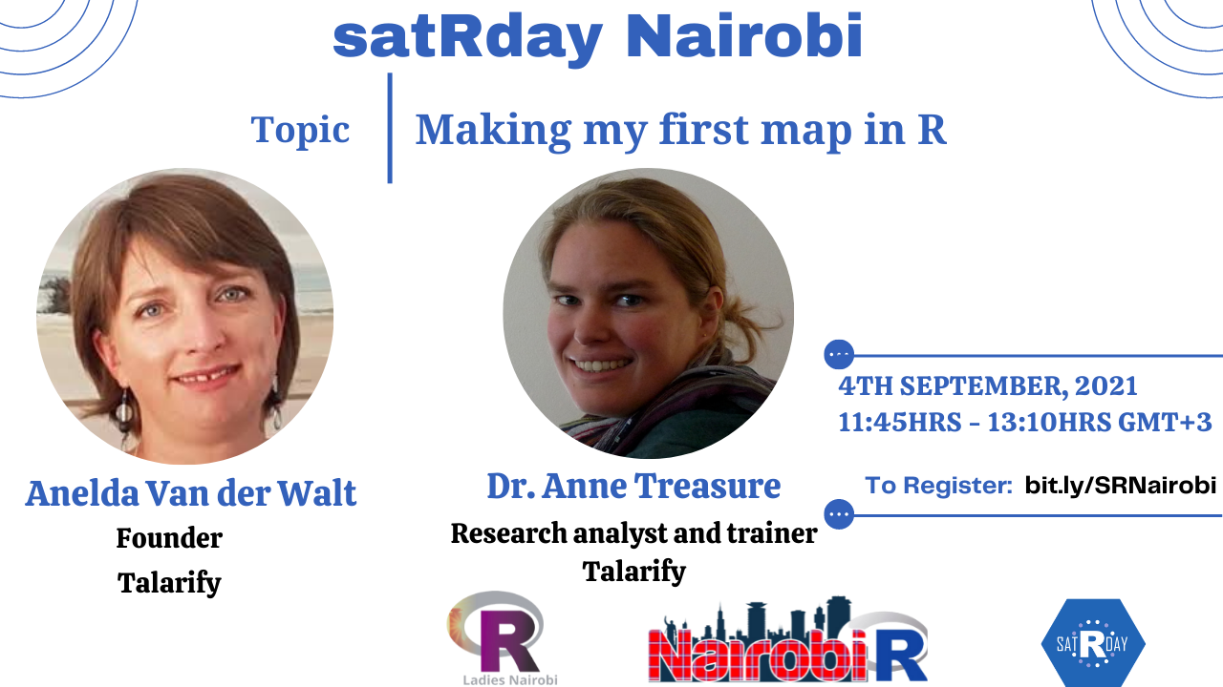

Slide 2
Agenda
Time | Activity | Speaker/ Moderator
09:50 am | Participants joining
09:50 am - 09::55 am | Welcoming remarks and introducing the speaker | Shelmith Kariuki/ John Mutiso
09:55 am – 11:00 am | Making my first map in R | Anelda Van der Walt and Dr. Anne Treasure
11:00 am - 11:15 am | Q & A | Anelda Van der Walt and Dr. Anne Treasure/ Shelmith Kariuki/ John Mutiso

Slide 3
Training Session

Slide 4
Q & A

Slide 5



THANK YOU
Email address: nairobi@rladies.org
LinkedIn: R-Ladies Nairobi
Twitter: @RLadiesNairobi/ #NairobiR
Meetup: https://www.meetup.com/rladies-nairobi/

